Slide 1

Loan Default Prediction
Machine Learning Approach
Pooja Sureja
18th February 2022

Slide 2
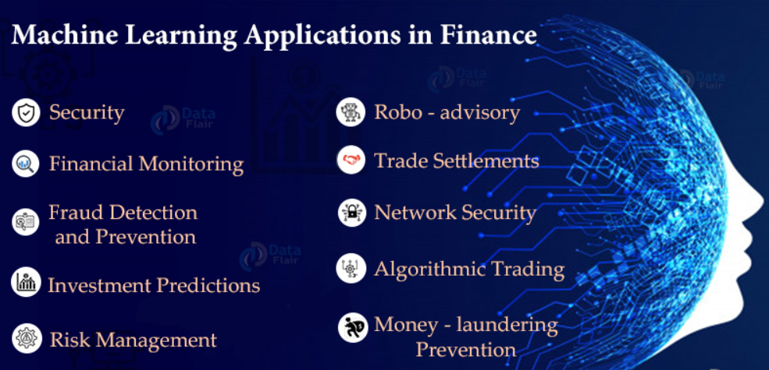
Machine learning in the Financial sector

Slide 3
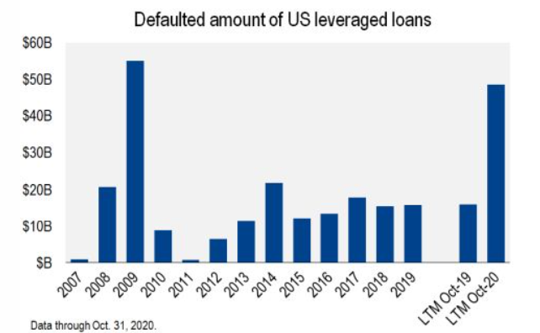
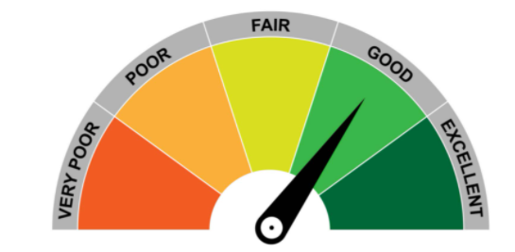
Loan Default
Hires: High Professional Individuals
Time - Taking Process
Manual Process
Hires: Easy to hire individuals
Less time taking
ML Algorithm to predict score and approve loan

Slide 4

Objective
Create a predictive model to classify each borrower as defaulter or not using the data collected when the loan has been given
Minimize the risk of borrowers defaulting the loans using the created model.

Slide 5
● Our problem can be expressed as a Supervised learning problem where we have the target variable specified. We have used supervised learning algorithms like Random Forest, Decision Tree and XGBoost Classifier.
Problem Statement
To classify if the borrower will default the loan using the borrower’s financial history. That means, given a set of new predictor variables, we need to predict the target variable as 1 -> Defaulter 0 -> Non-Defaulter.

Slide 6
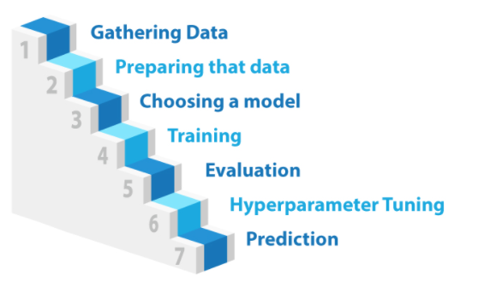
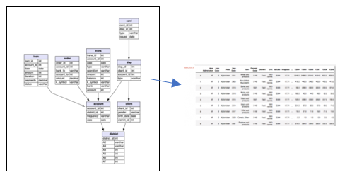
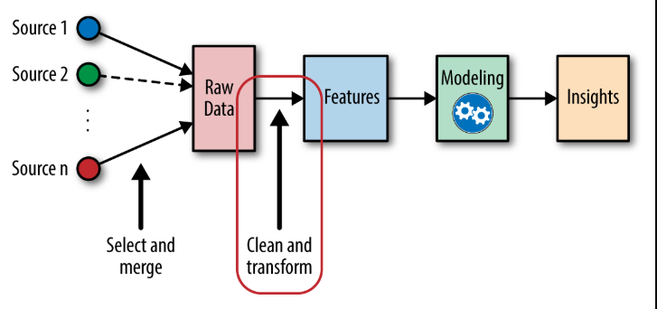
SQL , Python
Pandas, NumPy
Encoding, Null Value Handling
Cross Validation
My Approach towards the Project
Machine learning Algorithms – Sk-learn
Random SerchCV, Grid Search CV
Accuracy,F1 score ,ROC-AUC Score

Slide 7
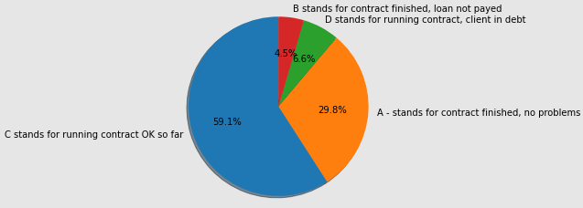
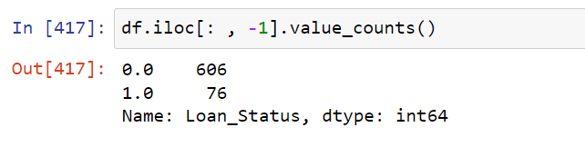
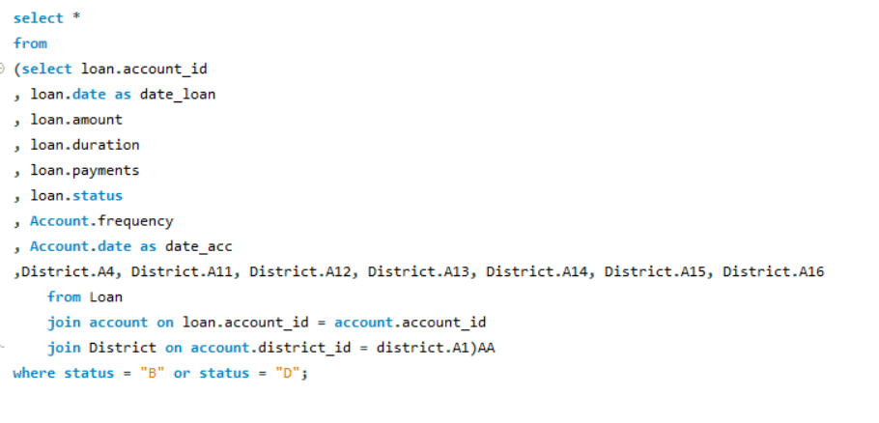
Data Analysis
Technique Used in Data Analysis
SQL
Matplotlib

Slide 8
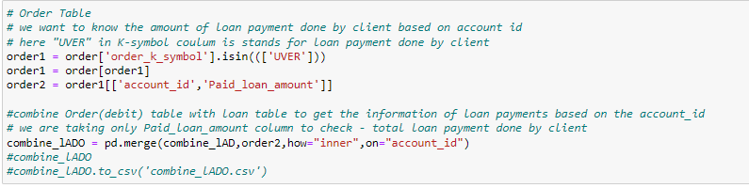
Data Collecting
Technique Used in Data collection and FE
Pandas
NumPy
The dataset had many empty and irrelevant features They have been removed.
Redundant variables have been dropped.
Filled NAN values with mean values of corresponding columns
Use join, merge, and other SQL terms to combine data

Slide 9
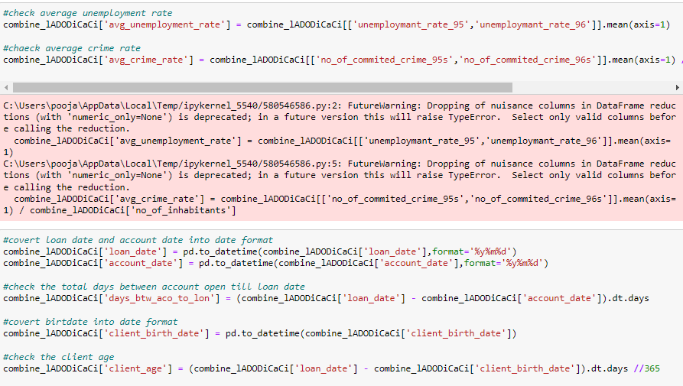
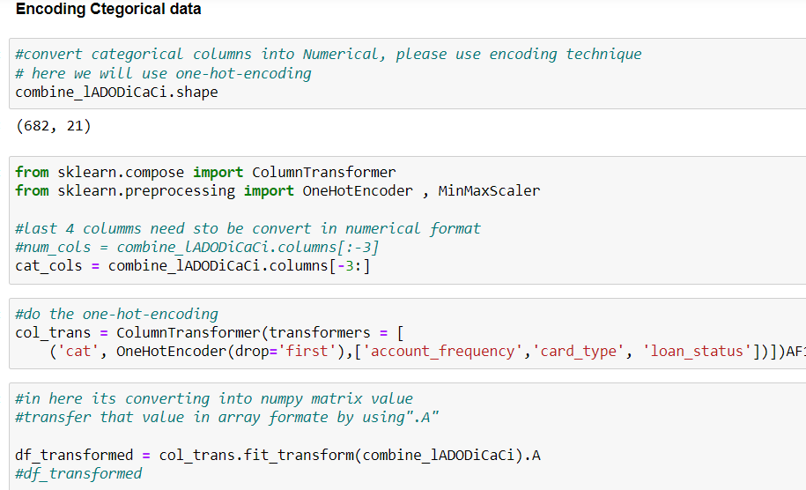
Feature Engineering
The dataset had many empty and irrelevant features They have been removed.
● String values have been formatted to integers.
● Categorical values have been transformed to numerical. – encoding Technique
● Redundant variables have been dropped.
● Filled NAN values with mean values of corresponding columns.

Slide 10
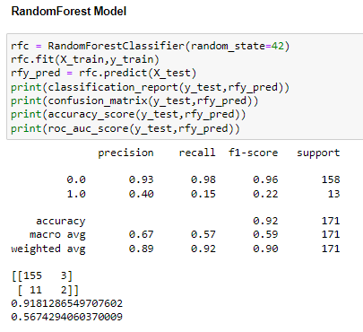
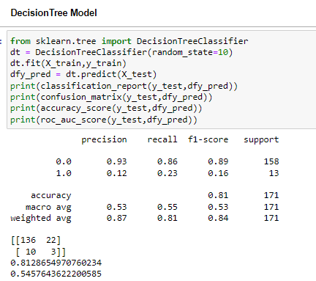
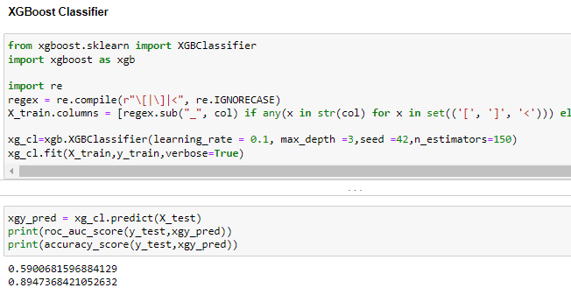
- Random Forests Classification. - Decision Tree Classification - XGBoost Classifier
Machine Learning Model Applied

Slide 11
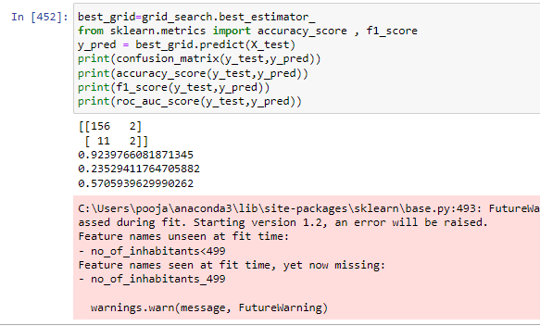
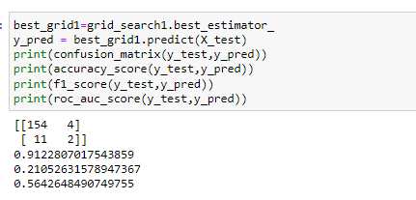
Hyperparameter Tuning Using Grid-Search CV
Random Forest
XGBoost Classifier

Slide 12
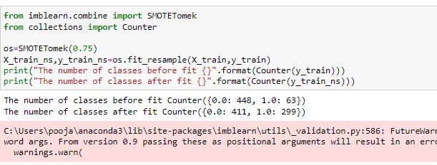
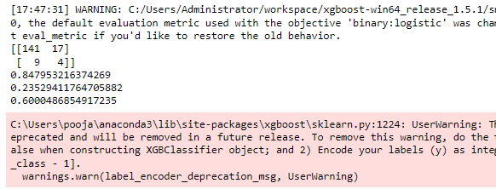
XGBoost Classifier with SMOTE Technique

Slide 13
Conclusion
Result
Accuracy Score: 0.84 %
On the other hand, when the model is used on the test set, the result is not quite satisfying: most of the bad loans are labeled as “good” and the F1 score is only 0.267.
Roc-Auc Score is also relatively low as 0.6
There is evidence that overfitting is involved
Top Features
Loan Amount
Average Salary
Days between account creation and loan application
Loan Duration
This project is a classification problem, which leverages the loan and customer history information to predict whether the customer will default the loan.
The goal is to use the model as a tool to help make decisions on issuing the loans.

Slide 14

Future Scope:
We have already used the F1 score and ROC AUC instead of just accuracy. However, the performance is still not as good as it could be.
In order to solve this problem, we can add transactions table in Model
I used Random Forest, XGBoost Classifier, but in future we can use SVM, Logistic regression etc.

